Slide 1



UFR Sciences de la Vie et de l'Environnement
Master 1 de biologie, écologie et évolution, parcours modélisation en écologie
Modeling and predicting earthworm diversity and distribution in France: A comparative approach using multiple algorithms
Abdourahmane DIALLO
Internship supervisor
Daniel CLUZEAU,
Kevin HOEFFNER
Walid HORRIGUE
Laboratory
UMR 6553 ECOBIO –Université de Rennes
UMR 1347 Agroécologie (INRAE de Dijon)
Internship from January 01 to June 30, 2024

Slide 2
Introduction
Prediction algorithms:
SDMs « species distribution modèles »
Correlations between species or communities and their environment (Elith & Leathwick, 2009; Guisan et al., 2017)
Various SDMs exist, each with its own advantages and disadvantages (Li & Wang, 2013; Valavi et al., 2021)

Slide 3

Introduction
Prediction algorithms:
SDMs « species distribution modèles »
Correlations between species or communities and their environment (Elith & Leathwick, 2009; Guisan et al., 2017)
Various SDMs exist, each with its own advantages and disadvantages (Li & Wang, 2013; Valavi et al., 2021)
Which algorithms are best for predicting earthworm communities
Comparative approach of multiple SDMs (Salako et al., 2023)
Reduce the uncertainty associated with predictions
Identify the best model for each earthworm variable (abundance, biomass, and richness)

Slide 4
Introduction
Traditional regression algorithms :
Generalized Linear Models (GLM) (Rutgers et al., 2016)
Generalized Additive Models (GAM) (Salako et al., 2023)
Machine learning algorithms:
Random Forests (RF) (Salako et al., 2023)
Generalized Boosted Regression Models (GBM) (Fourcade & Vercauteren, 2022)
Artificial Neural Networks (ANN)
Widely used in recent studies (Li & Wang, 2013; Rutgers et al., 2016; Valavi et al., 2021; Fourcade & Vercauteren, 2022; Salako et al., 2023).

Slide 5
Introduction
Objectives
Compare prediction algorithms
Quantify and rank the influence of environmental factors based on their contribution to predictive models of earthworm abundance (individuals per m²), biomass (g per m²), and total taxonomic richness (number of taxa in the plot)
Predict earthworm diversity and distribution

Slide 6
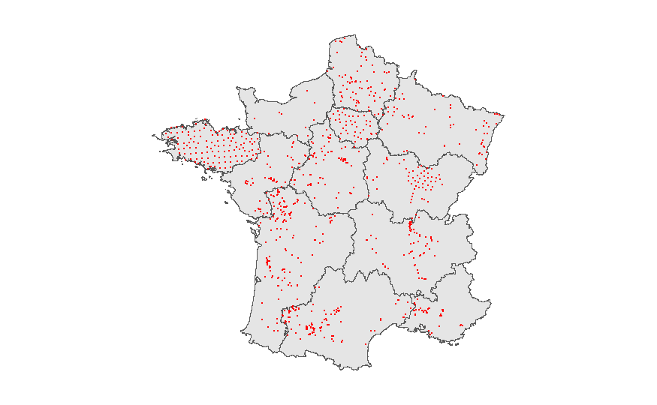
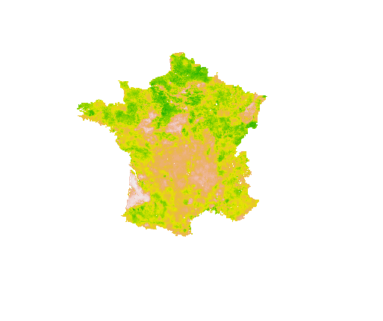
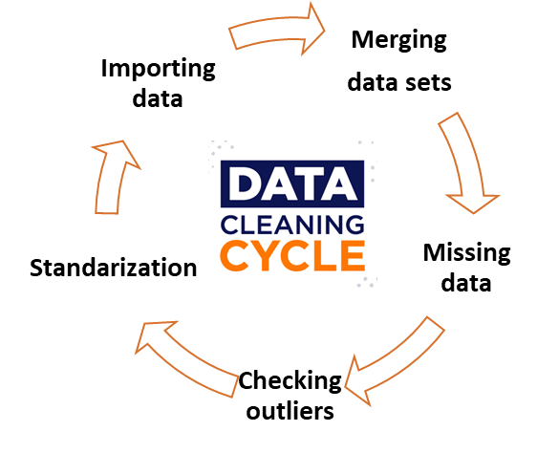
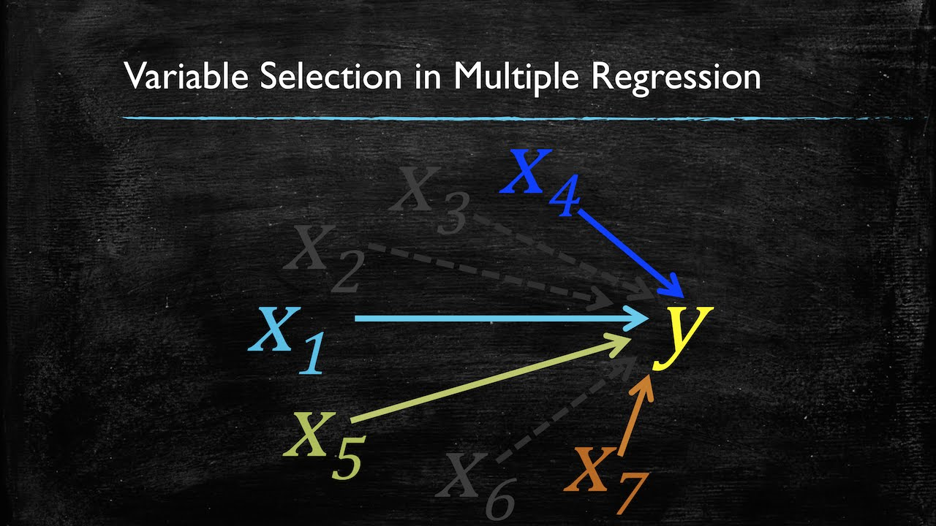
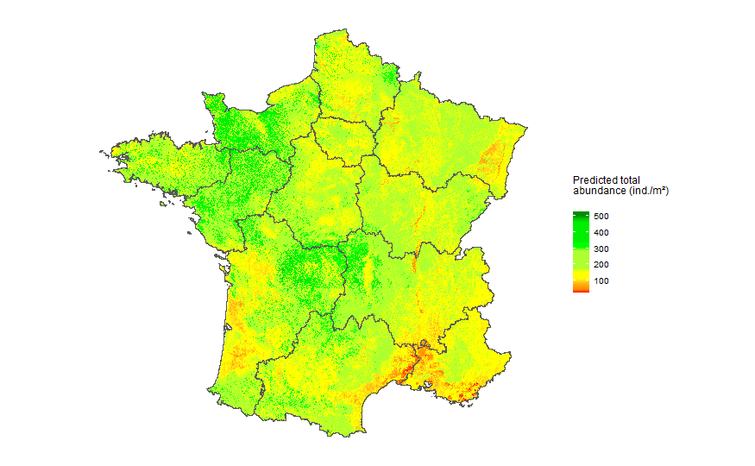
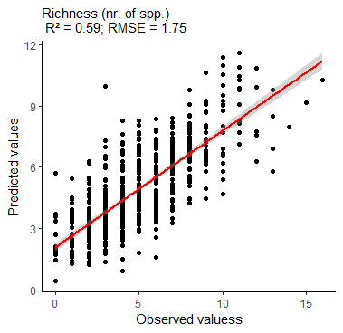
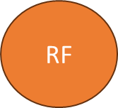
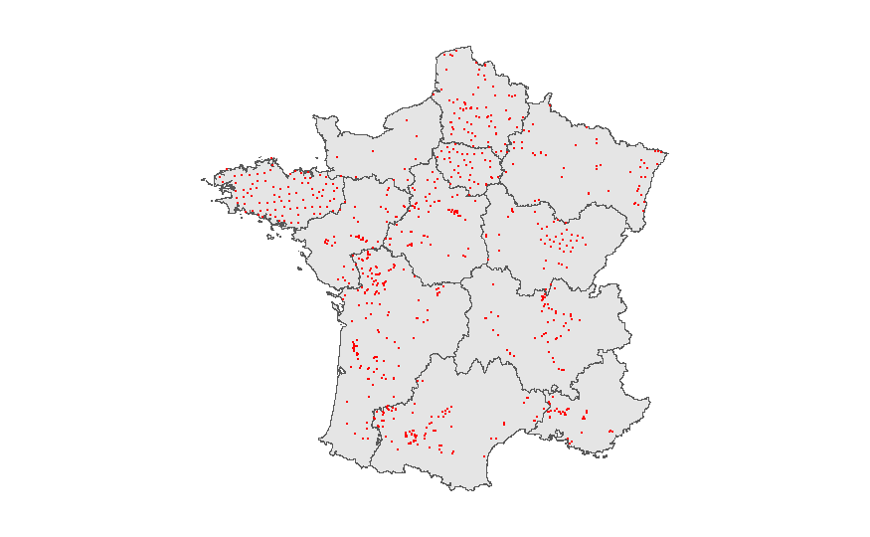
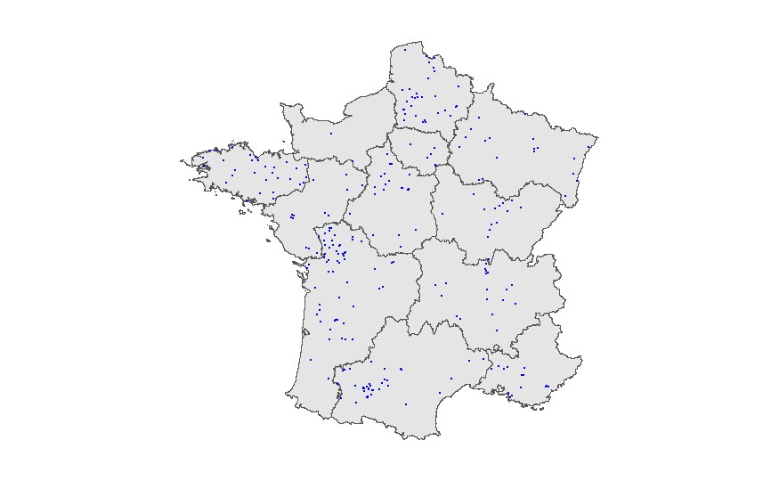
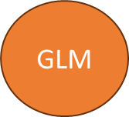
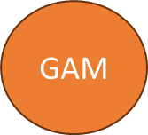
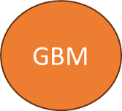
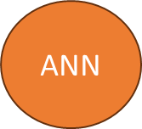
Materials and methods
Modeling strategy
ODMAP protocol: Overview, Data, Model, Assessment, Prediction Zurell et al. (2020)
1 Biological data
2 Environmental data
3 Data cleaning
4 Variable selection
8 Prediction
7 Evaluation & selection
6 Model fitting & calibration
5 Data partitioning
Training data Test data

Slide 7
Materials and methods
1. Collection and selection of earthworm data
LandWorm (2023-2026 FRB-MTE-OFB)
8019 earthworm observations
Between 1821 and 2023
7

Slide 8
Materials and methods
1. Collection and selection of earthworm data
LandWorm (2023-2026 FRB-MTE-OFB)
8019 earthworm observations
Between 1821 and 2023
Hand-sorting(ISO 23611-1:2018) and/or application of a chemical expellant (formaldehyde or allyl isothiocyanate; ISO 23611-1:2006).
8

Slide 9
Materials and methods
1. Collection and selection of earthworm data
LandWorm (2023-2026 FRB-MTE-OFB)
8019 earthworm observations
Between 1821 and 2023
Hand-sorting(ISO 23611-1:2018) and/or application of a chemical expellant (formaldehyde or allyl isothiocyanate; ISO 23611-1:2006).
LandWorm (2023-2026 FRB-MTE-OFB)
6188 earthworm observations
Between 1990 and 2023
9

Slide 10
Materials and methods
2. Environmental data collection
Category | Descriptions | Time scale | Reference | Resolution
LAND COVER | Forest (broad-leaved forest, coniferous forest and mixed forest) | 1990 - 2023 | LandWorm database
 | Pastures, meadows and other permanent grasslands under agricultural use
 | Non-irrigated arable land (annuel crop, inter crop, market gardening)
 | Green urban areas (urban lawn, ornamental massif, urban allotment garden, urban forest)
 | Vineyards
 | Natural grasslands
SPATIAL | Longitude
 | Latitude
CLIMAT | 19 standard bioclimatic variables: annual precipitation, annual mean temperature,… | 1981 - 2010 | CHELSA (Karger et al., 2017) | 30 arc-second, ~ 800 m
SOIL | Silt | 2022 | Roman Dobarco et al., 2022 | 90 m
 | Clay
 | Sand
 | pH | 2009 - 2012 | JRC (Ballabio et al., 2019) | 250 m
 | Calcium carbonates (CaCO3)
 | C/N
 | Carbone content
 | Azote (N)
 | Phosphore (P)
 | Potassium (K)

Slide 11


Materials and methods
2. Environmental data collection
Data harmonization:
World Geodetic System (WGS84) coordinate system,
Resampled or disaggregated to a common resolution of 800 m

Slide 12


Slide 13
Materials and methods
3. Data cleaning
Removal of NAs and outliers (Grubbs' test, 0.05 threshold)
Categorical variables: Binary transformation
Temporal repetition (test)

Slide 14
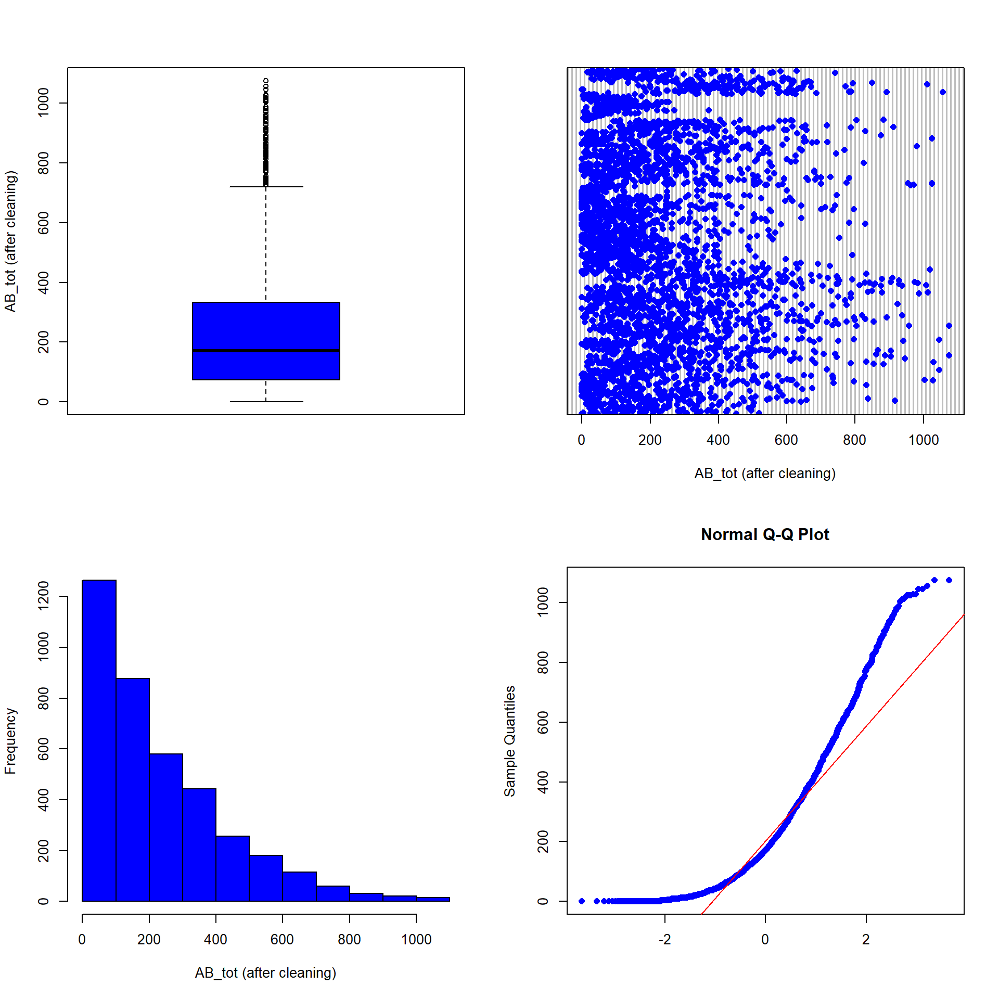
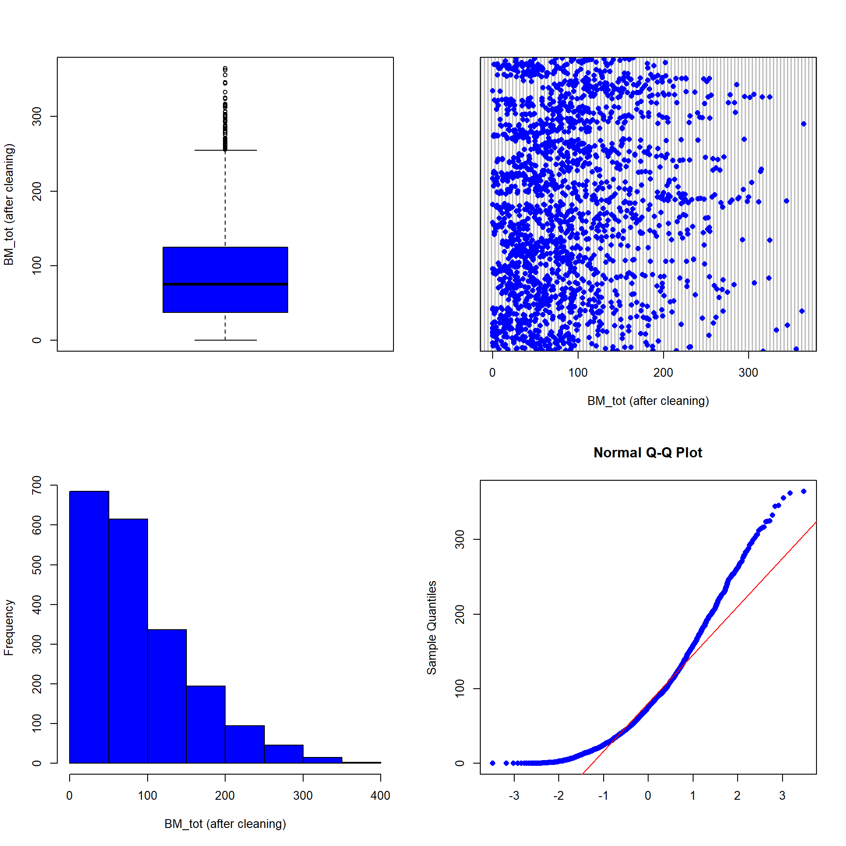
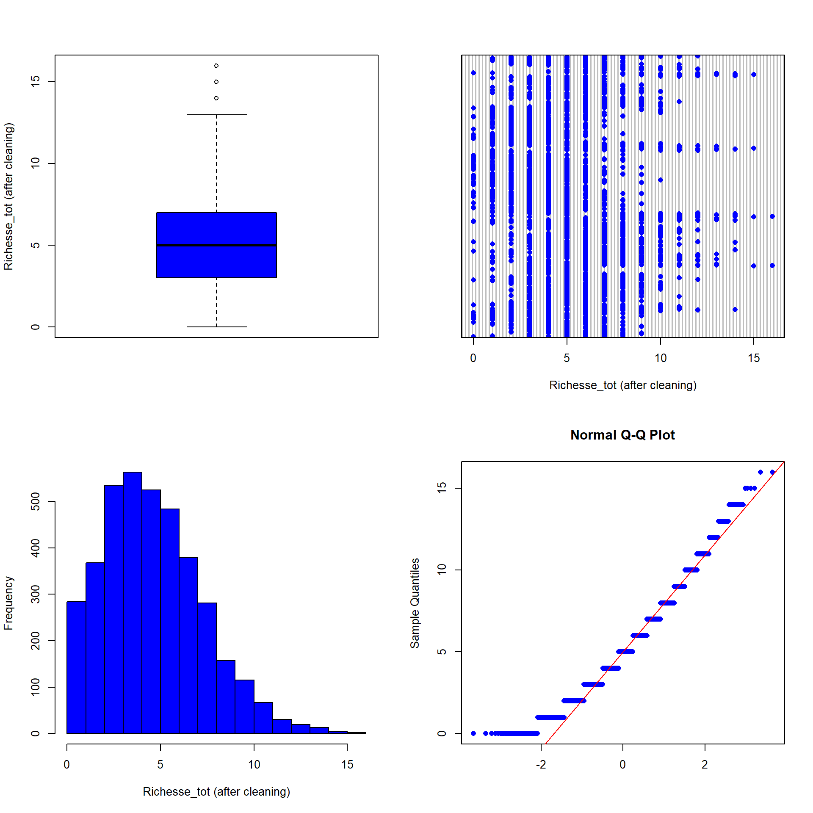

Materials and methods
3. Data cleaning
Removal of NAs and outliers (Grubbs' test, 0.05 threshold)
Categorical variables: Binary transformation
Temporal repetition (test)
Total abundance (ind./m²) Total biomass (g/m²) Total taxonomic richness

Slide 15
Materials and methods
3. Data cleaning
Numerical variables: Standardized transformation
Abundance and biomass: Square root transformation (test)

Slide 16
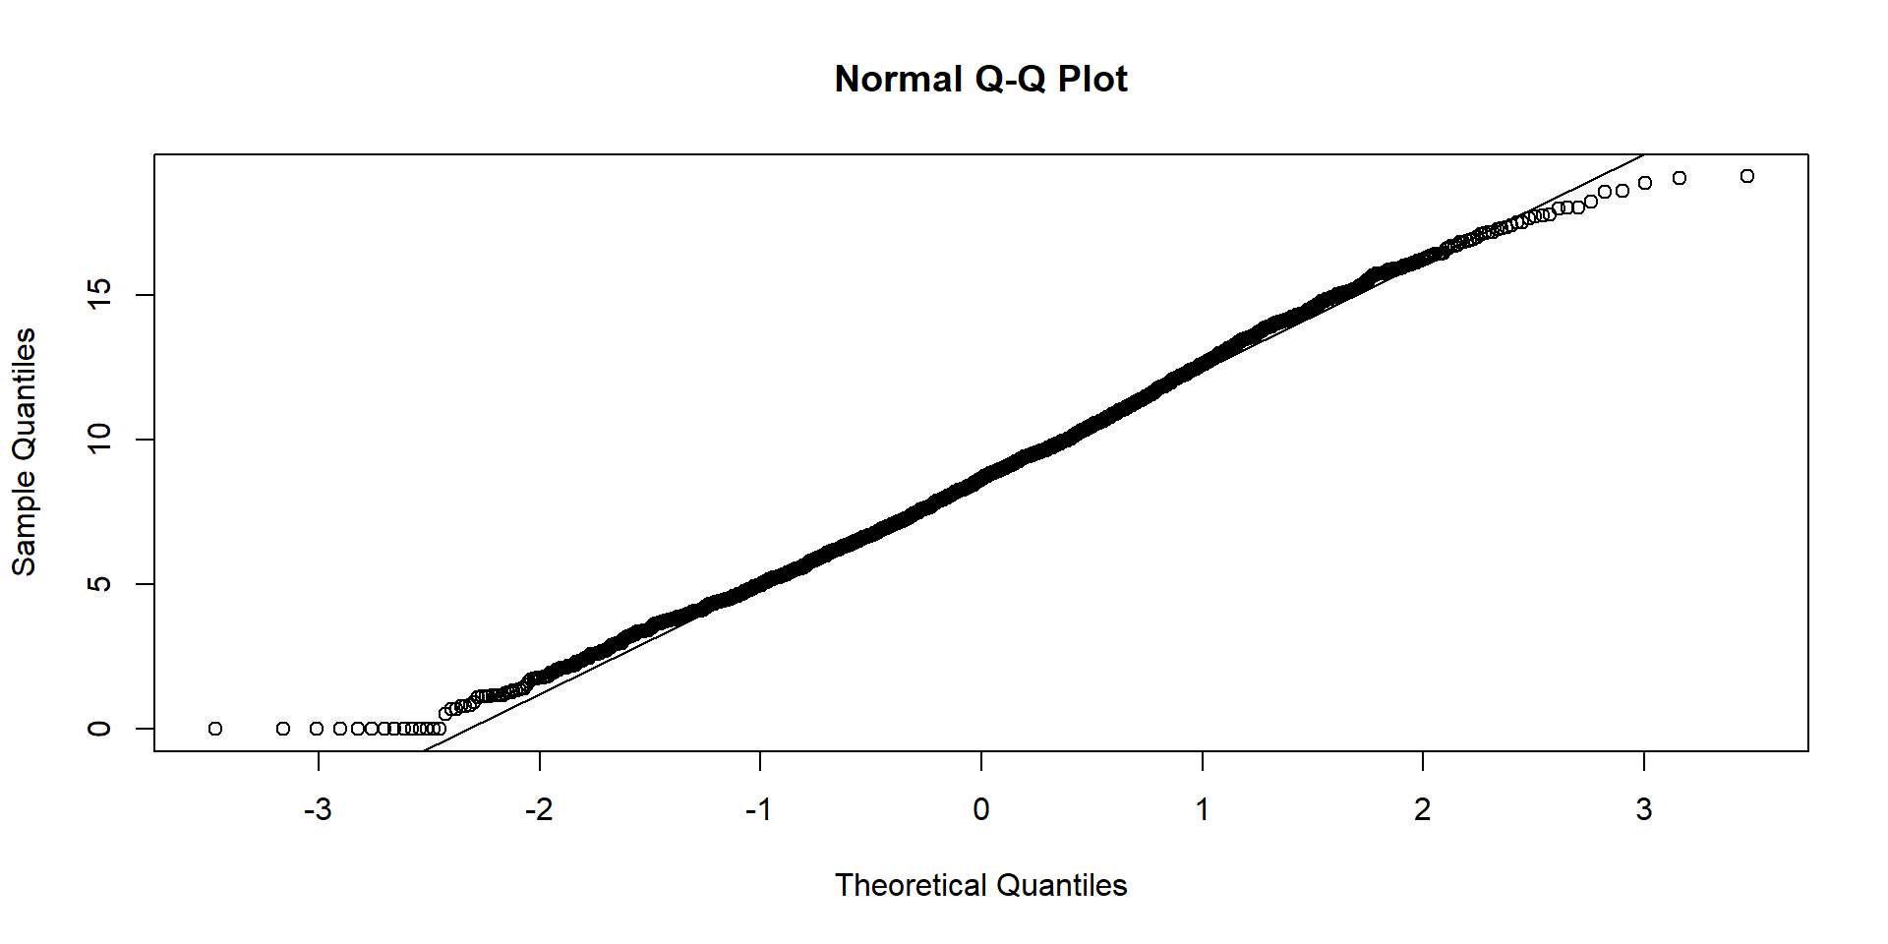
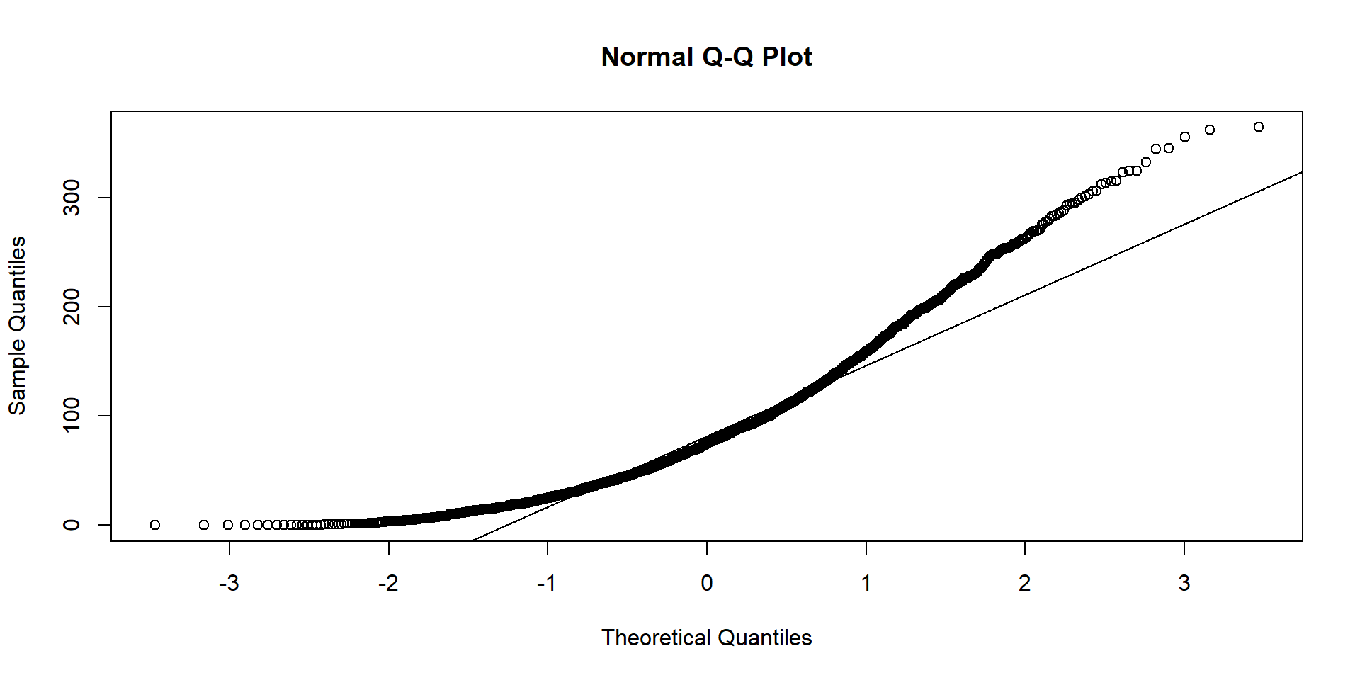
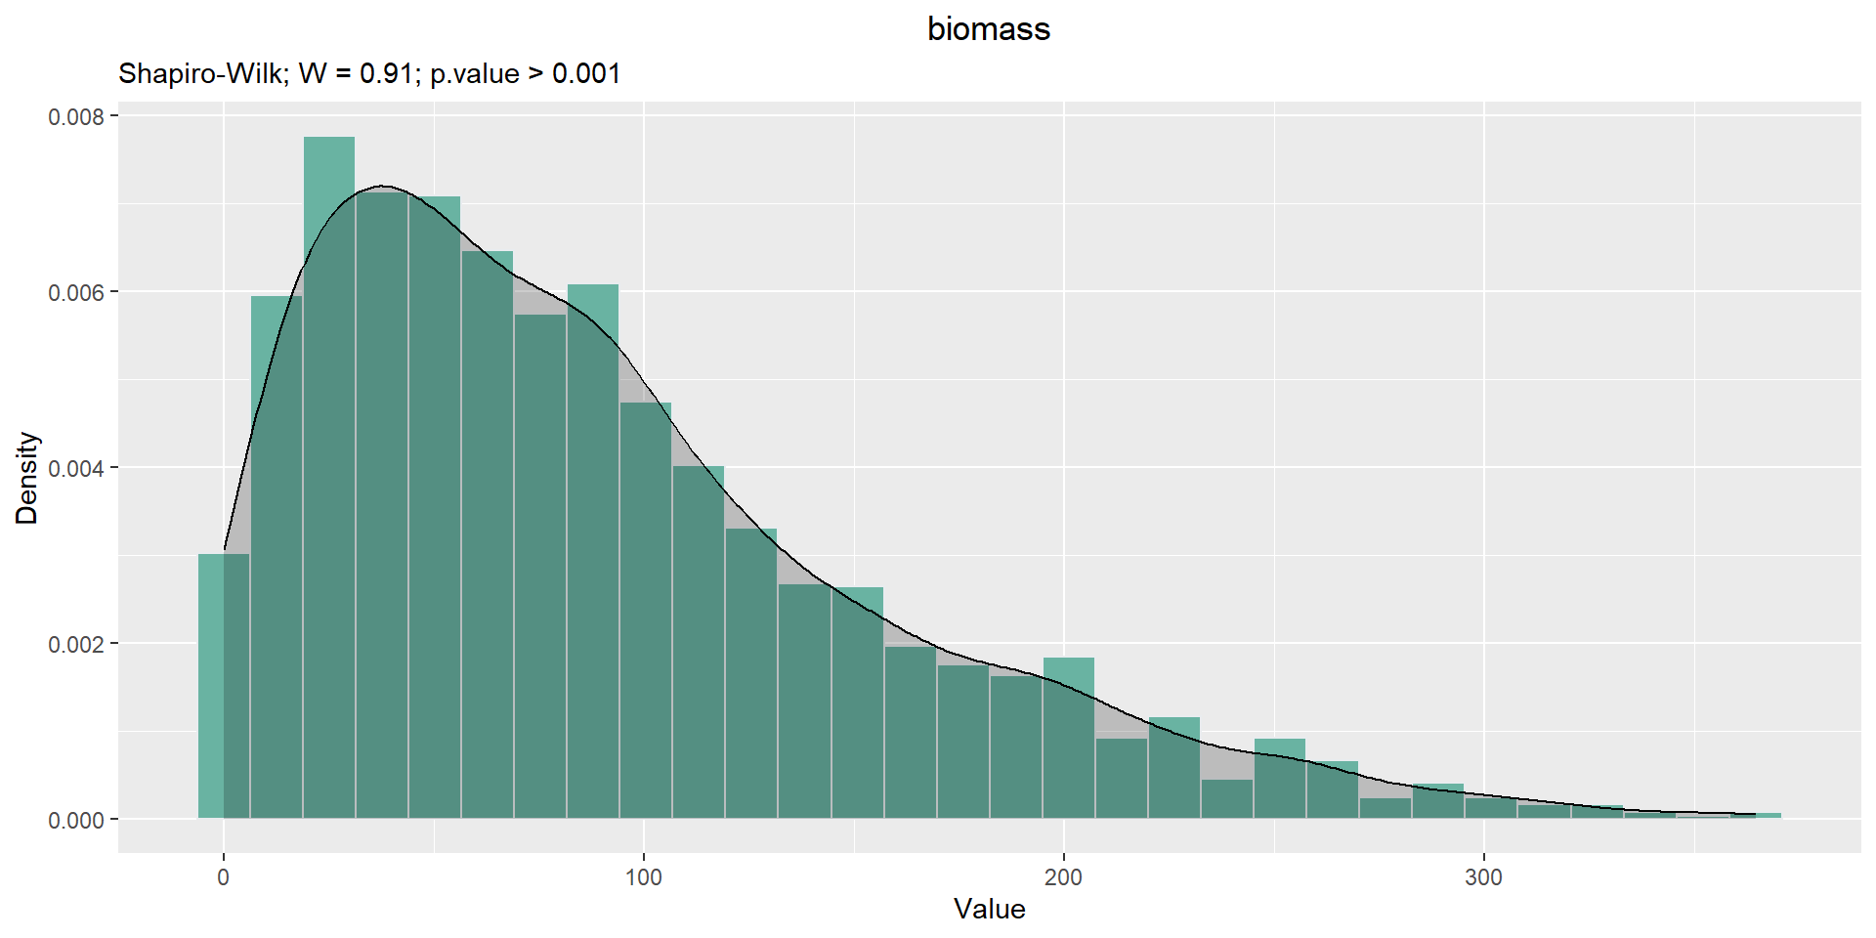
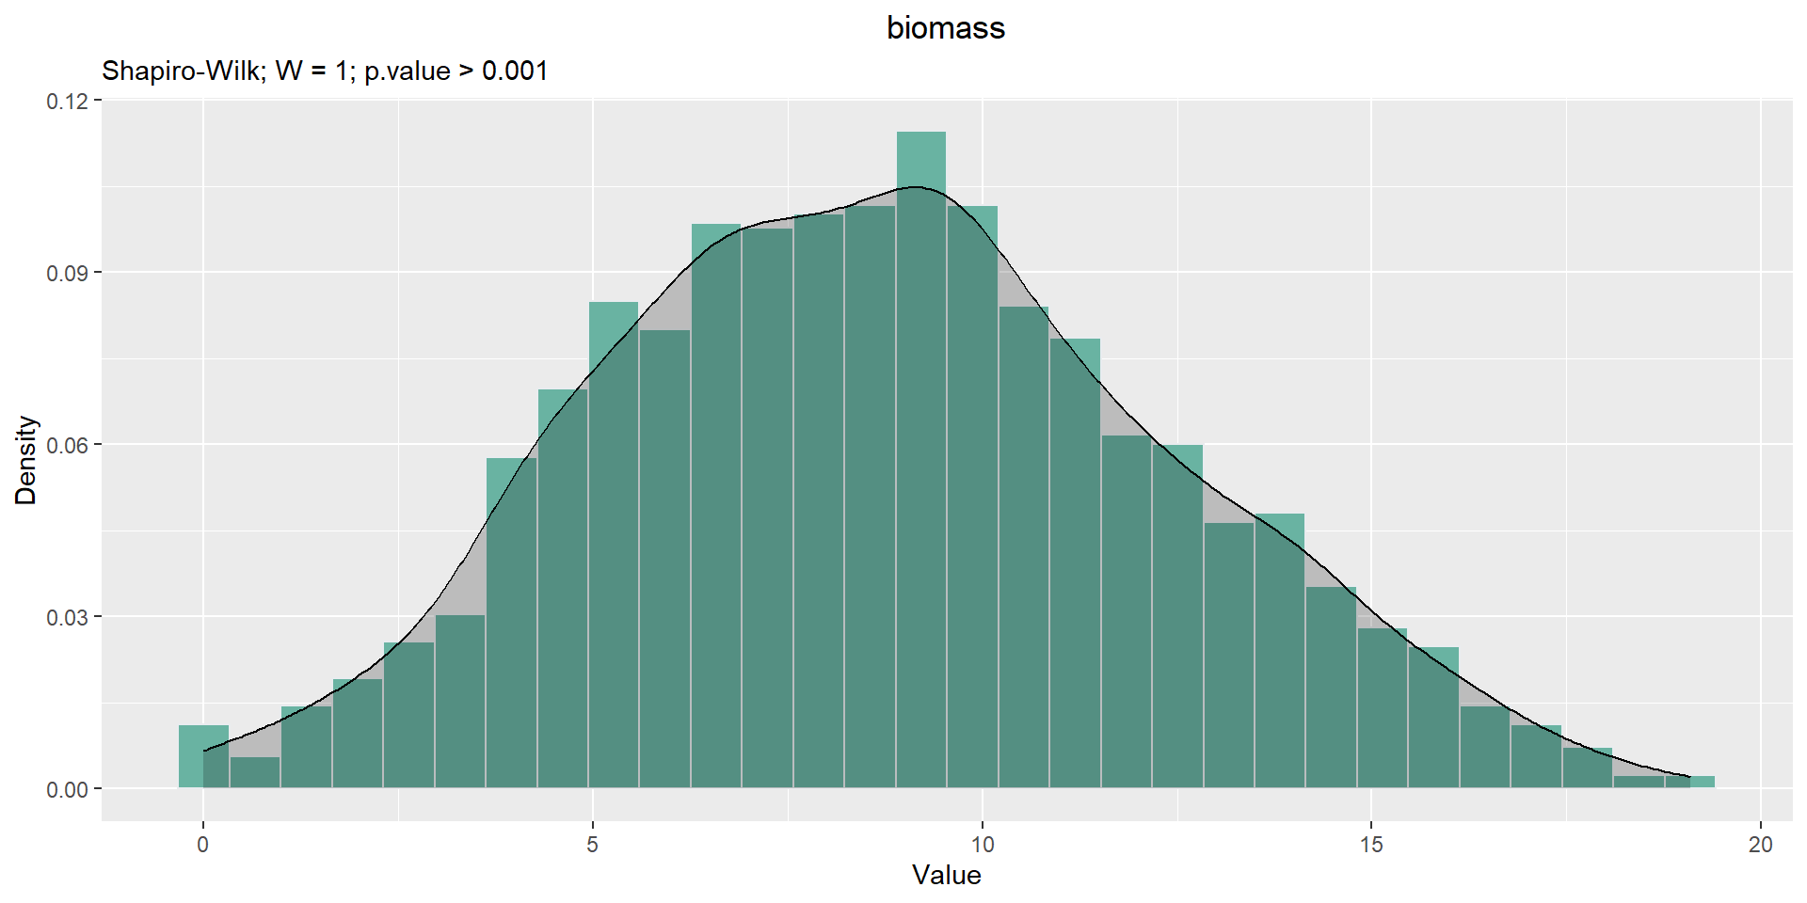
Materials and methods
3. Data cleaning
Numerical variables: Standardized transformation
Abundance and biomass: Square root transformation (test)
Total biomass (g/m²)

Slide 18
Materials and methods
4. Variable selection
Category | Abbr | Description
LandCover | For | Forest (all types)
 | Gua | Green urban areas
 | Nag | Natural grasslands
 | Nial | Non-irrigated arable land
 | Pmo | Pastures, meadows and other permanent grasslands under agricultural use
 | Viny | Vineyards
Location | Long | Longitude
 | Lat | Latitude
Climate | bio12 | Annual precipitation amount
 | bio3 | Isothermality
Soil | Clay | Clay particles
 | Silt | Silt particles
 | CaCO3 | Calcium carbonates
 | P | Phosphorus
 | N | Nitrogen
Random Forrest model:
Variable importance (Fourcade & Vercauteren, 2022; Zeiss et al., 2024)
Avoid overfitting (Vaughan et Ormerod, 2005)
Notes:
Citer ref

Slide 19

Materials and methods
5. Data partitioning
Data partition (3758, 16):
Train data (80 %) = 3006 rows, 16 columns
Test data (20 %) = 752 rows, 16 columns
(non-significant Kolmogorov-Smirnov test, p-value > 0.05) (Guisan et al., 2017)
Notes:
K cross validation, Test, Good balance 80:20, Distribution (resonse var and predictors),

Slide 20
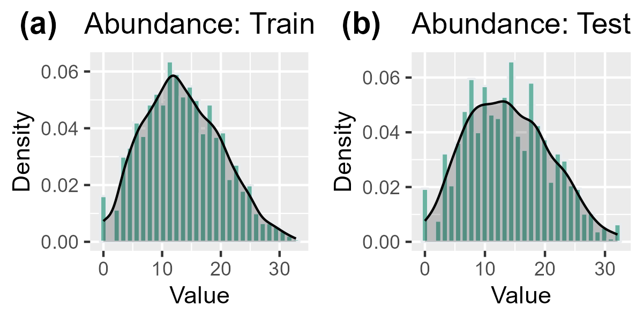
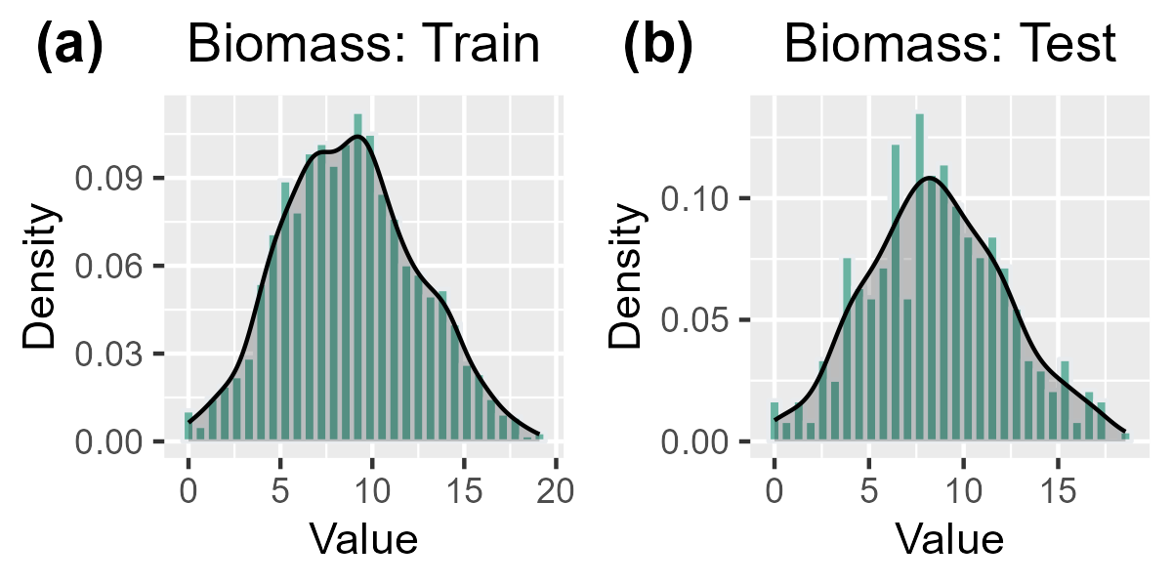
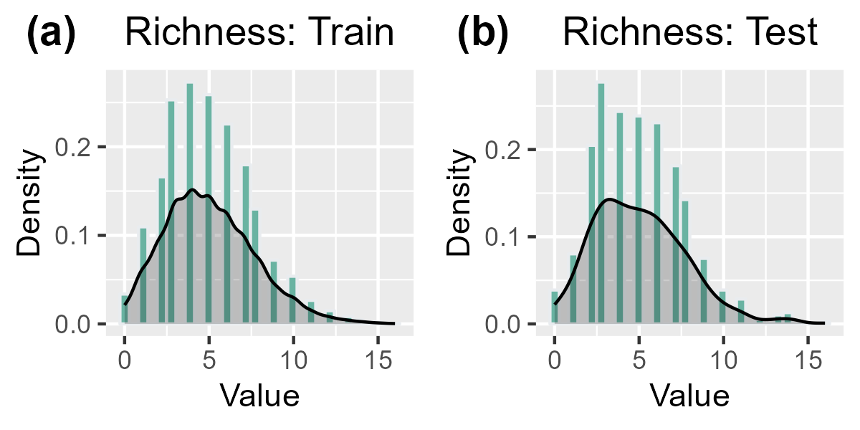
Materials and methods
5. Data partitioning
Data partition (3758, 16):
Train data (80 %) = 3006 rows, 16 columns
Test data (20 %) = 752 rows, 16 columns
(non-significant Kolmogorov-Smirnov test, p-value > 0.05) (Guisan et al., 2017)
Notes:
K cross validation, Test, Good balance 80:20, Distribution (resonse var and predictors),

Slide 22
Materials and methods
6. Model fitting and calibration
Generalized Linear Models (GLM)
Traditional regression algorithms
$$Y =\text{glm}\text{(}\text{y} \text{\sim }\text{x}\text{1 + }\text{x}\text{2 + … + }\text{xn}\text{, }\text{family}\text{ = ′}\text{gaussian}\text{′, }\text{data}\text{ = }\text{data}\text{)}$$
Generalized Additive Models (GAM)
$$Y = gam(y \sim s\left(x1\right)+ s\left(x2\right)+ … + s\left(xn\right), family=′gaussian^{′}, method =′\text{REML}\text{′}, data = data)$$
Notes:
Le REML est une méthode d’estimation des paramètres dans les modèles statistiques qui maximise la vraisemblance des résidus, offrant des avantages tels que des estimations non biaisées et une robustesse face aux violations de l’hypothèse de normalité.

Slide 23
Materials and methods
6. Model fitting and calibration
Default model
Machine learning algorithms
$$Y = randomForest (data[−rep.var],data[[rep.var]],importance=TRUE)$$
RF model tuning by grid
ntree = 100, 300, 500, 700, 900, 1000, 1300, 1500, 1700 and 2000
mtry = 2, 4, 6, 8 and 10
maxnodes = NULL, 10, 20, 30, 40, 50, 60, 70, 80, and 90
Total number of models = ntree ∗ mtry ∗ maxnode
Random Forests (RF)
$$Y = randomForest (data[−rep.var],data[[rep.var]],mtry = 3,ntree = 500,maxnodes = NULL,importance=TRUE)$$

Slide 24
Materials and methods
6. Model fitting and calibration
Default model
Machine learning algorithms
$$Y = gbm(y \sim .,data=data,distribution =′ gaussian′)$$
GBM model tuning by grid
n.trees = 1000, 1500, 1700, 2000 and 3000
shrinkage = 0.01, 0.02, 0.05, 0.001, 0.002 and 0.005
interaction.depth = 3, 5, 6, 8 and 10
n.minobsinnode = 2, 5, 10, 30, 50 and 70
Total number of models = n.trees∗shrinkage∗interaction.depth∗n.minobsinnode
Generalized Boosted regression Models (GBM)
$$Y = gbm(y \sim .,data=data,distribution =′ gaussian′,n.trees=1000,shrinkage= 0.01,interaction.depth=5,n.minobsinnode=10)$$

Slide 25
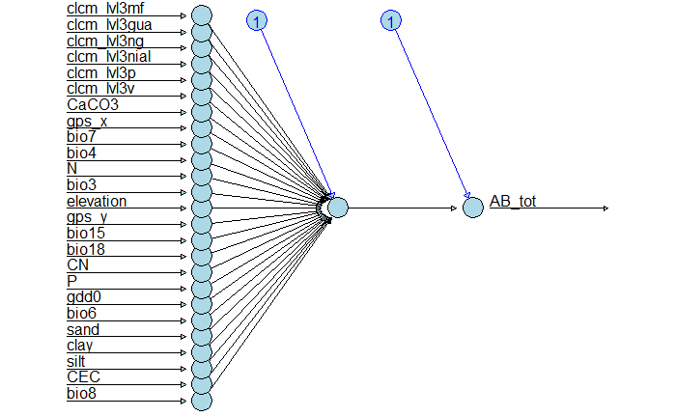
Materials and methods
6. Model fitting and calibration
Machine learning algorithms
keras (Kalinowski et al., 2024)
Sequential architecture
Activation function = ReLU
ANN_tune_AB_tot %>% keras::compile(loss = 'mse', optimizer = 'rmsprop', metrics = 'mae')
Artificial Neural Networks (ANN)
epochs = 100, batch_size = 64, validation_split = 0.2.
Notes:
input_shape = 15

Slide 26
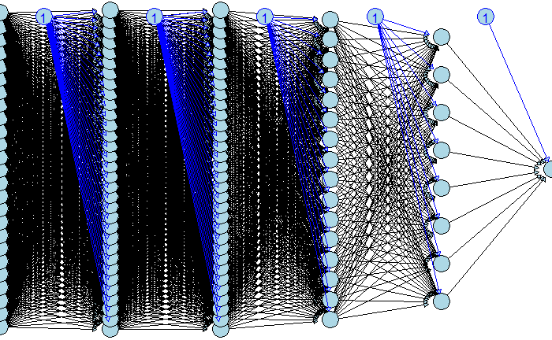
Materials and methods
6. Model fitting and calibration
Machine learning algorithms
Tunning
runs = tuning_run(“Experiment.R”, flags = list(dense_units1 = c(64, 32), dense_units2 = c(16, 32), dense_units3 = c(8, 16), dense_units4 = c(4, 8),
dropout1 = c(0.4, 0.5), dropout2 = c(0.3, 0.4), dropout3 = c(0.2, 0.3), dropout4 = c(0.1, 0.2), batch_size = c(32, 64)))
Artificial Neural Networks (ANN)

Slide 28

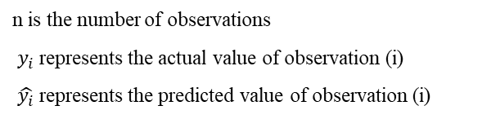
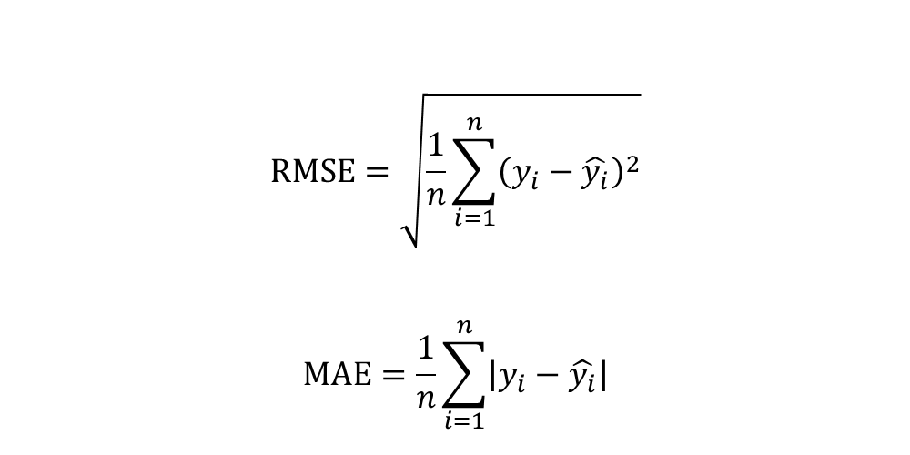
Materials and methods
7. Model evaluation & selection
Train data: model fitting
Test data: performance evaluation
R² (Coefficient of determination)
Observations (field data)
Predictions
$$\text{RMSE}=\sqrt{\frac{1}{n}\sum_{i=1}^{n}{{\left(y_{i}−\hat{y_{i}}\right)}^{2}}}$$
$$\text{MAE}=\frac{1}{n}\sum_{i=1}^{n}{\left|y_{i}−\hat{y_{i}}\right|}$$
Root Mean Square Error :
Absolute Mean Error :
n is the number of observations
$y_{i}$ represents the actual value of observation (i)
$\hat{y_{i}}$ represents the predicted value of observation (i)

Slide 30

Materials and methods
8. Prediction & mapping
Environmental data collection
Prediction using the best model
NA
Proximity interpolation
Trend surfaces
Kriging
800m
Interpolation :
Notes:
The parameter 𝑝 is the weighting parameter that is applied as an exponent to the distance. A large 𝑝 indicates that nearby points exert a much greater influence on the unsampled location than a distant point.

Slide 31
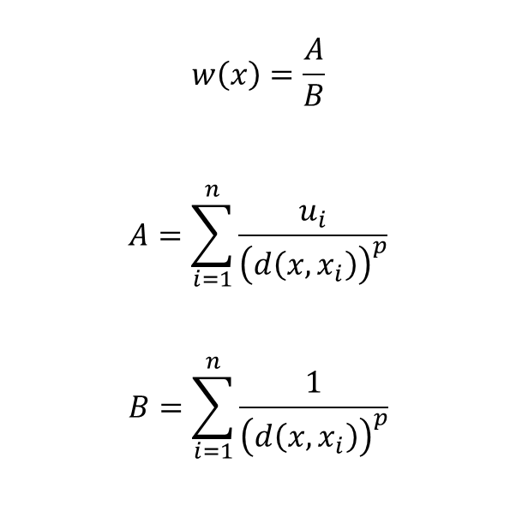
Materials and methods
8. Prediction
Environmental data collection
Prediction using the best model
NA
Proximity interpolation
Trend surfaces
Kriging
800m
Interpolation :
Inverse Distance Weighting (IDW )
(Hijmans et al., 2023; Pebesma & Graeler, 2023)
$$w\left(x\right)=\frac{A}{B}$$
$$A=\sum_{i=1}^{n}{\frac{u_{i}}{{\left(d\left(x,x_{i}\right)\right)}^{p}}}$$
$$B=\sum_{i=1}^{n}{\frac{1}{{\left(d\left(x,x_{i}\right)\right)}^{p}}}$$
w is the predicted value,
x is the unknown point,
n is the number of sampling points (n = 10)
d is the distance,
xi is the n-th know point,
ui is the value of the know point,
p is the power coefficient (p = 10) and
Notes:
The parameter 𝑝 is the weighting parameter that is applied as an exponent to the distance. A large 𝑝 indicates that nearby points exert a much greater influence on the unsampled location than a distant point.

Slide 32
Materials and methods
8. Prediction
800m
Cartography
Approximate biodiversity:
Overlay of abundance and richness maps (salako et al., 2023)

Slide 34
Results and discussions
Superiority of ensemble methods in predicting earthworm communities compared to traditional regression models
Algorithms | Response variables | R² | RMSE
GLM | Total abundance | 0.22 | 34.57
GAM |  | 0.26 | 33.06
RF |  | 0.43 | 25.20
GBM |  | 0.43 | 25.30
ANN |  | 0.35 | 28.94
GLM | Total biomass | 0.23 | 10.69
GAM |  | 0.24 | 10.50
RF |  | 0.35 | 8.76
GBM |  | 0.32 | 9.30
ANN |  | 0.27 | 10.50
GLM | Total taxonomic richness | 0.36 | 2.18
GAM |  | 0.44 | 2.04
RF |  | 0.59 | 1.75
GBM |  | 0.59 | 1.75
ANN |  | 0.40 | 2.16
Ensemble methods (Breiman, 2001; Li & Wang, 2013)
Better captures nonlinear relationships
Robust to outliers Incorporates interactions between variables (Breiman, 2001)
Require large amounts of data (Yiu, 2021)
Poor interpretability (not really true now)

Slide 35
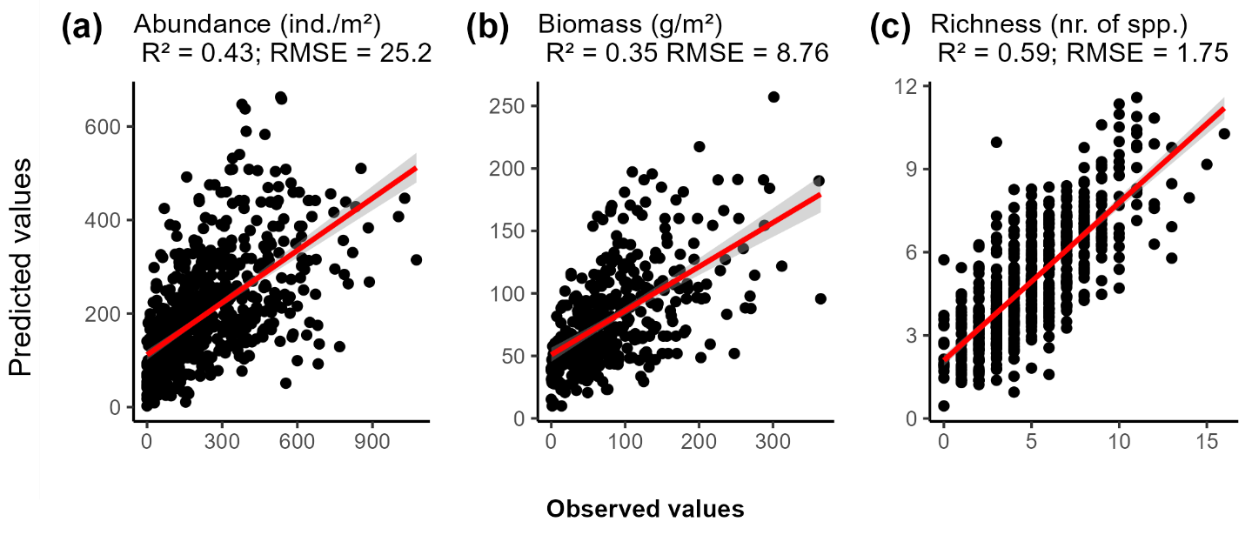
Results and discussions
Superiority of ensemble methods in predicting earthworm communities compared to traditional regression models
RF RF GBM
Notes:
Less data on total biomass
Climate and soil variables come from external databases Six types of land use

Slide 36
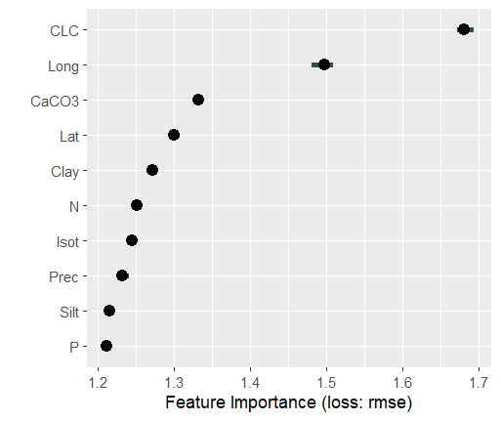
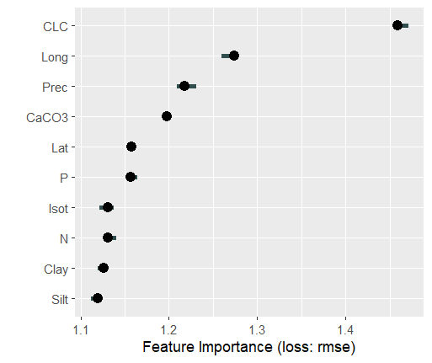
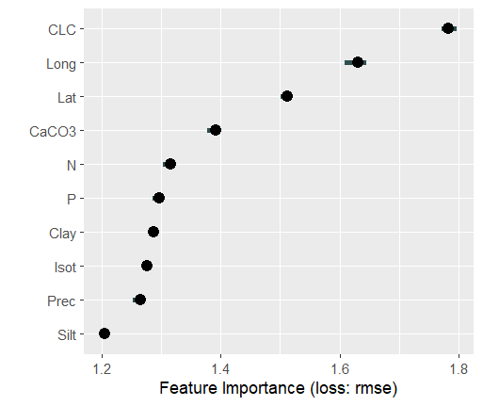
Results and discussions
Land cover was the most important variable for earthworms
RF: Abundance (ind./m²)
RF : Biomass (g/m²)
GBM: Richness (nr. of spp. )

Slide 38
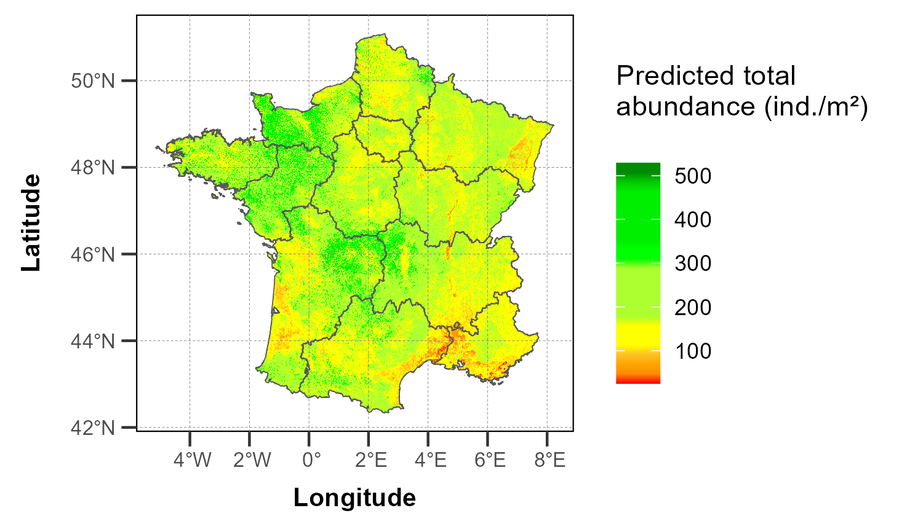
Results and discussions
Predicted spatial distribution of earthworm community

Slide 39
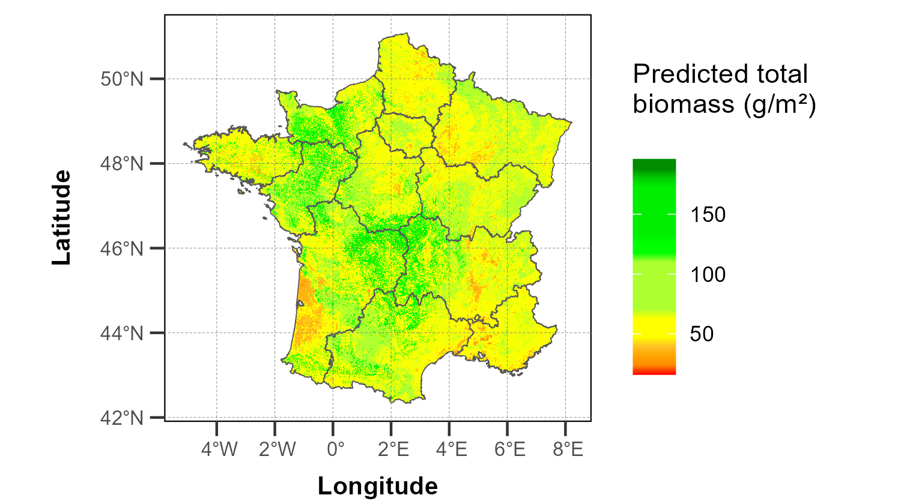
Results and discussions
Predicted spatial distribution of earthworm community

Slide 40
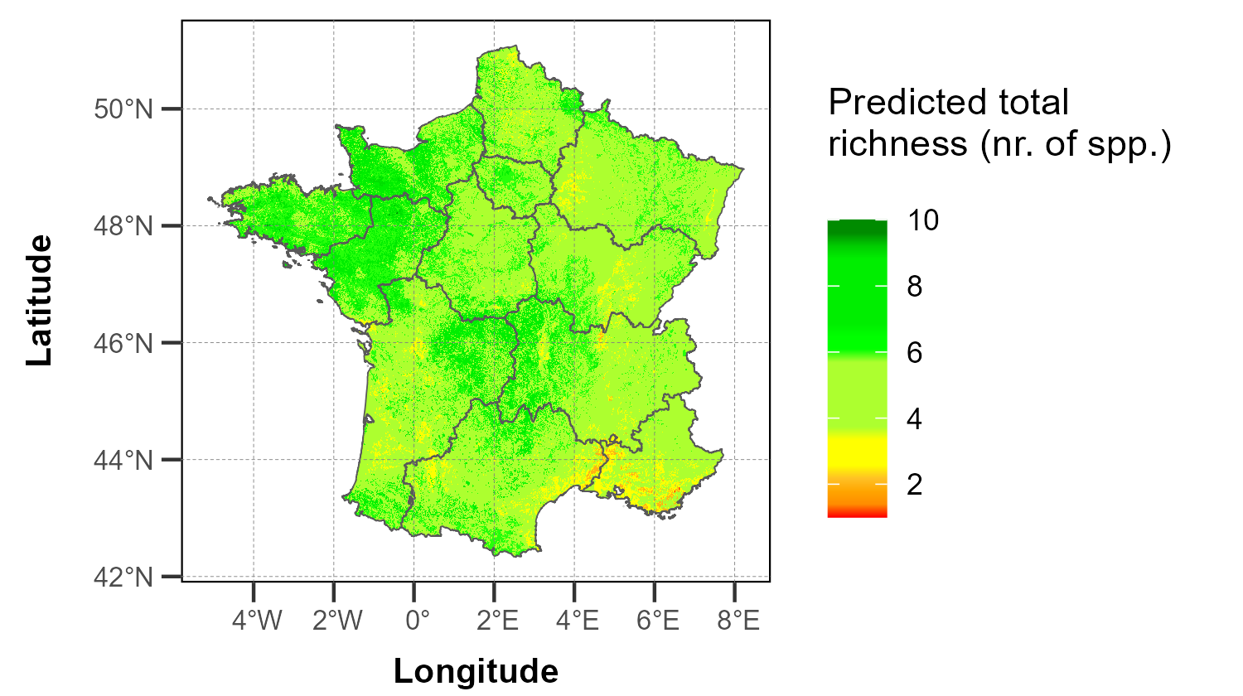
Results and discussions
Predicted spatial distribution of earthworm community

Slide 41
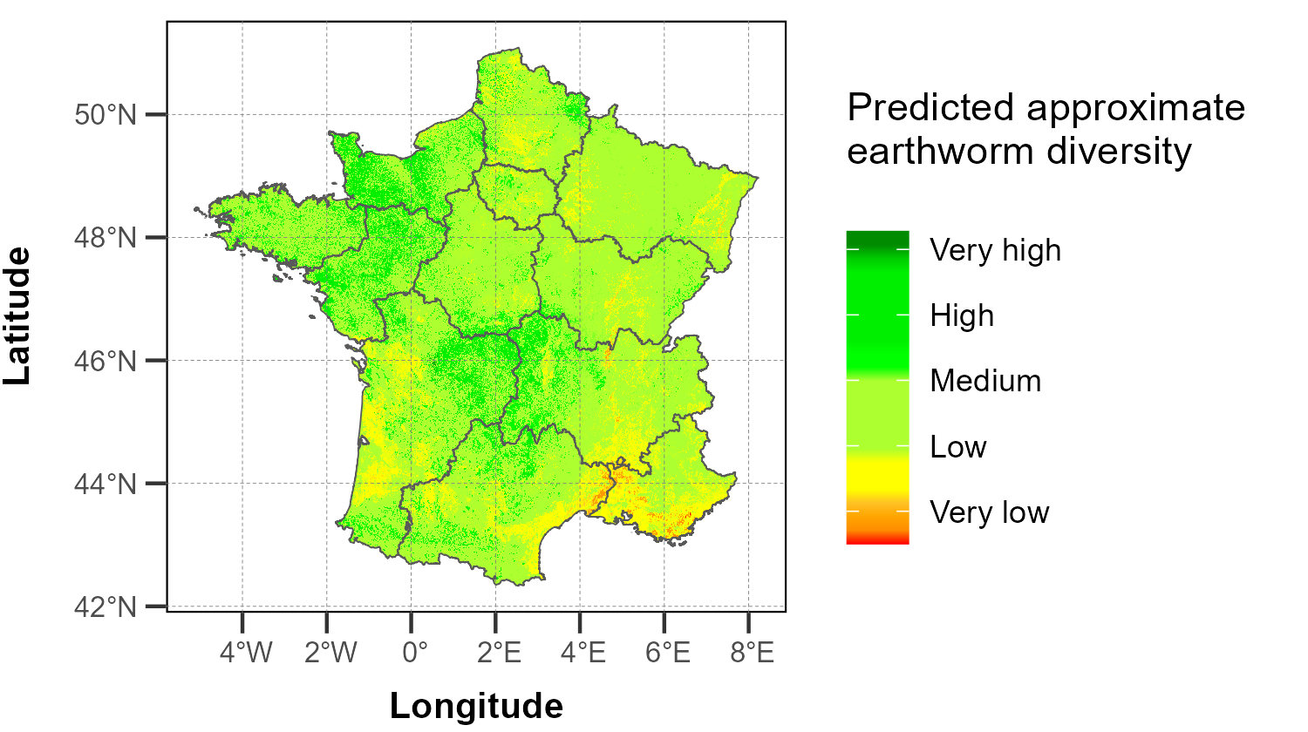
Results and discussions
Predicted spatial distribution of earthworm community

Slide 43
Thank you for your attention

Slide 45
Additional information
All the material from my internship, including scripts and datasets, is available on my GitHub and my Rpubs.

Slide 46
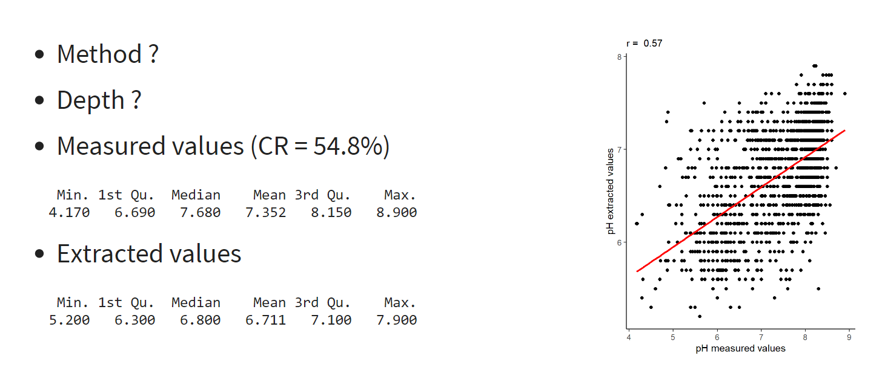
pH

Slide 47
Conclusion
0 1
GLM GAM ANN GBM RF
Very low Low Medium High
Importance
Soil Climate Topography Land use

Slide 48
Bibliography

Slide 49

Acknowledgements
Kevin Hoeffner
Daniel Cluzeau
Walid Horrigue
All my colleagues from the LMCU team

Slide 51
Materials and methods
1 Biological data
2 Environmental data
3 Data cleaning
Modeling strategy
5 Data partitioning
4 Variable selection
80 % 20 %
ODMAP protocol
Zurell et al. (2020)
Training data Test data
6 Model Fitting
7 Evaluation
8 Prediction

Slide 52
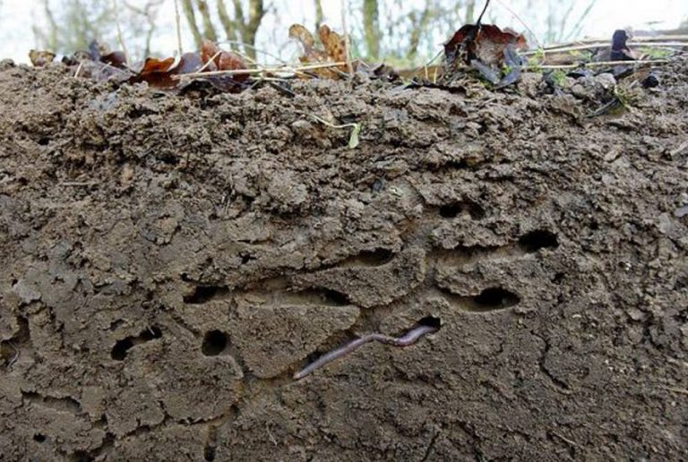
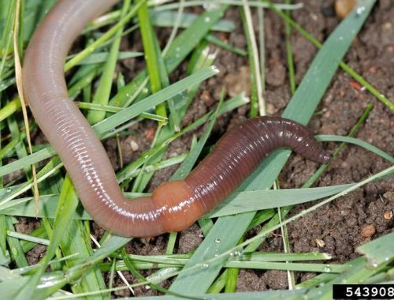
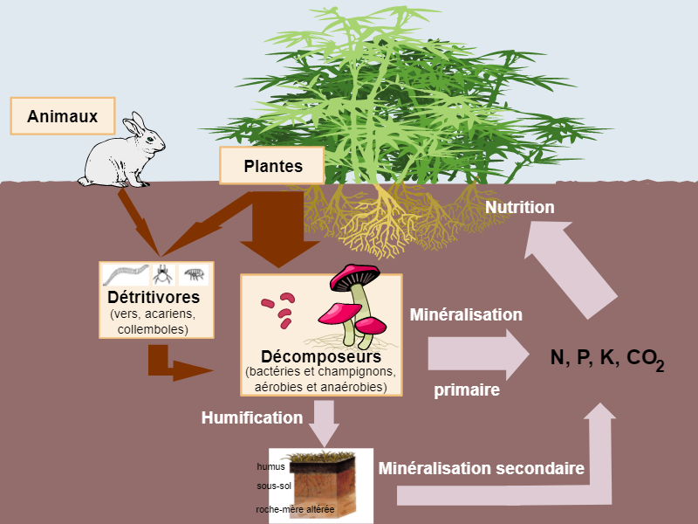
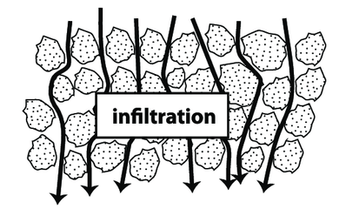
Introduction
Biodiversity in terrestrial ecosystems is primarily composed of the fauna living in the soil (FAO, 2020; Anthony et al., 2023)
Soil structure (Bouin et al., 2013;
Edwards & Arancon, 2022)
Earthworms
Nutrient cycle
(Lemtiri et al., 2014,
van Groenigen et al., 2014 )
«ecosystem engineers »
(Brown et al., 2004)
Soil bioindicators (Paoletti, 1999)
Water infiltration
(Capowiez et al., 2014; Cunha et al., 2016)

Slide 53


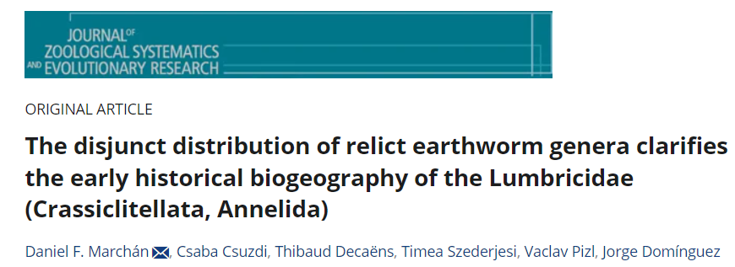

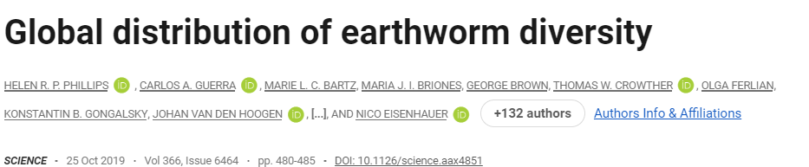
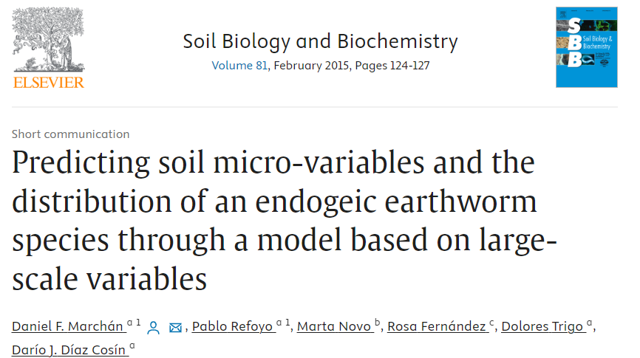
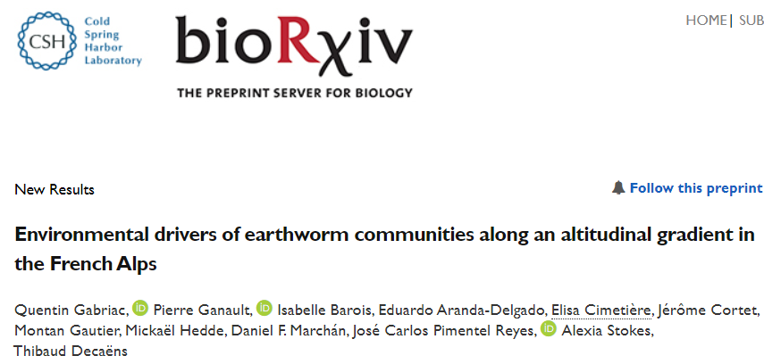
Introduction
Effects of anthropic and environmental factors on earthworms
Local and regional scales national scales
One type of predictive modeling algorithm:
generalized linear models for Rutgers et al. (2016);
generalized linear mixed-effects models for Phillips et al. (2019)

Slide 54
Hypotheses
Climate variables and land use type are the most influential factors on earthworm abundance and biomass, while land use type and soil texture have a greater influence on species richness.

